Slide 1

PROJECT STAKEHOLDER MANAGEMENT
Chibamba Simumba

Slide 2

Agenda
Introduction
What is Project Stakeholder Management?
The Importance of Project Stakeholder Management
Project Stakeholder Management Process
Conclusion

Slide 3
Introduction
The end goal of any project management undertaking is to meet and exceed stakeholders’ expectations. This goal can only be achieved if we can identify all the stakeholders because some may be difficult to identify, for instance, internal competitors.
Project Stakeholder Management is an essential step in any project management undertaking.
To effectively involve stakeholders in project decisions and execution, it is necessary to identify the key individuals, groups, or organisations that could impact or be affected by the project.
It is also necessary to analyse stakeholder expectations and their impact on the project. If this step is managed correctly, the project management process is bound to succeed.

Slide 4

Section one
What is Project Stakeholder Management?

Slide 5

What is Project Stakeholder Management?
According to the PMBOK Guide, 2017, Project Stakeholder Management is the process of Identification of the individuals, groups, or organisations that could affect or be affected by the project, analysis of stakeholder expectations and their impact on the project, and development of appropriate management strategies for effectively involving stakeholders in project decisions and execution.

Slide 6
Section Two
The Importance of Project Stakeholder Management

Slide 7


What is the Importance of Project Stakeholder Management ?
Project stakeholders management is important because it helps to build consensus between the project team and the identified stakeholders. This process accords parties involved an opportunity to communicate and understand each other’s expectations in the project hand, leading to better management of expectations.
Project stakeholders management is also important because it helps to identify and categorise stakeholders based on their interests and how the project outcome will impact them.
Normally, stakeholders and the project have concerns about several things, especially at the start of any project. The project stakeholder management process helps stakeholders to understand and clear out these concerns. Stakeholders are worried as well. Ask them, and they will let you know if anything may happen to prevent your development. Other interested parties can describe how the project can affect their tasks and obligations.
The stakeholder management process is a continuous one. As such, it helps to lead to improved communication and collaboration between the project team and the stakeholders of the project at hand.
Conflict management is another reason why stakeholder management is important. Different expectations normally lead to conflicts between the stakeholders and the project team, and stakeholders management can help identify, manage and resolve any conflicts between parties.

Slide 8
Section Three
The Project Stakeholder Management Process

Slide 9
What Processes are Involved in the Project Stakeholder Management ?
The Project Stakeholder Management consists of four steps, namely;
Identifying stakeholders
Planning stakeholder engagement
Managing stakeholder engagement
Monitoring stakeholder engagement

Slide 10
Identifying stakeholders
Hughes B et al. 2012 define a stakeholder as anyone with a valid interest in an IT project or its products.

Slide 11
Types of Stakeholders
Generally, there are two categories of stakeholders. They can be internal or external to the organisation.
Internal Stakeholder
Internal project stakeholders often comprise the project sponsor, project team, support employees, and internal project customers. Because organisations have limited resources, additional internal stakeholders include:
top management,
other functional managers,
other project managers

Slide 12
Types of Stakeholders CONTD
External project stakeholders
External project stakeholders include the project’s clients (if they are external to the firm), rivals, suppliers, and other external groups that are potentially involved in the project or impacted by it, such as government officials and concerned citizens.
Governance Board
Suppliers
Governmental regulatory agencies
Competitors
Potential customers with an interest in the project
Groups representing consumer, environmental

Slide 13
Types of Stakeholders – cont’d
As earlier established, some project stakeholders may be hard to identify. For example, internal competitors might be opposed to the project without the Project manager’s knowledge.
Stakeholders could also change during a project due to personnel turnover, partnerships, and other events.
Therefore, it is important to use formal and informal communication networks to identify all key stakeholders.

Slide 14
Identifying stakeholders – cont’d
Stakeholder Register
Creating a stakeholder register is a straightforward approach to capturing basic information about project stakeholders.
A stakeholder register can be used to capture a variety of stakeholder information, as the ones below;
1.Identification information; For instance, names, positions, locations, roles in the project, and contact information.
2.Stakeholder classification; Whether the stakeholder is internal or external, Does the stakeholder support the project?
3.Assessment information; The stakeholders’ primary requirements and expectations, possible impacts, and project phases in which stakeholders have the most interest.

Slide 15
Identifying stakeholders – cont’d
Below is a figure showing a sample stakeholder register. It can be observed that the sample register below only includes basic information and not any sensitive information.
This is because this document is available to other members of the organisation.
Therefore, the project manager must be careful not to include sensitive information.

Slide 16
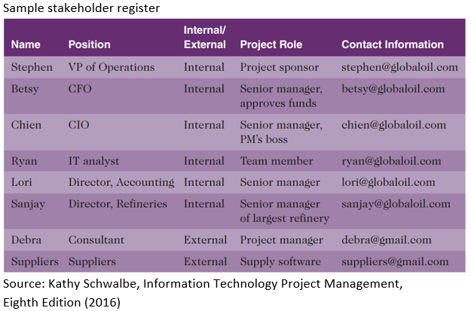
Sample Stakeholder Register

Slide 17
Create Work Breakdown Structure (WBS)
Stakeholder Analysis
Another important step that must be performed at this stage is called Stakeholder analysis. Schwalbe K. 2016 define Stakeholder Analysis as a strategy for assessing information to determine which stakeholders’ interests to focus on and how to build stakeholder support throughout the project.
After identifying all the stakeholders, a Power/ Interest Grid is used to classify and group them based on their authority level and concern or interest in the project’s outcome. The figure below provides a summary of the power/ interest grid.
Based on the grid, some stakeholder relationships require more attention to manage than others.

Slide 18
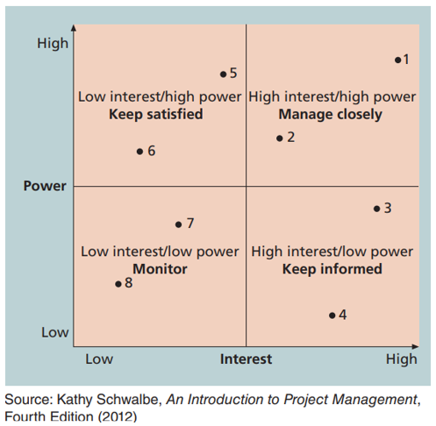
Create Work Breakdown Structure (WBS)
Power/ Interest Grid

Slide 19
Create Work Breakdown Structure (WBS)
2. Planning Stakeholder Engagement
Next, after identifying all the stakeholders, the project manager needs to formulate a stakeholder engagement plan to help effectively engage stakeholders and ensure that good decisions are made throughout the project management cycle.

Slide 20
Create Work Breakdown Structure (WBS)
What is a Stakeholder Engagement Plan?
A Stakeholder Engagement Plan is a systematic approach to communicating with project stakeholders to secure their support for the project.
It describes the frequency and kind of communications, medium, contact individuals, and places of communication events.

Slide 21
Planning Stakeholder Engagement – cont’d
In addition to the stakeholder register information, the Stakeholder Engagement Plan include the following information:
Current and desired engagement level; The project team should design a plan to align engagement levels if these levels are not the same.
Interrelationships between stakeholders; The project's stakeholders and operations are intricately linked. The project manager needs to be aware of the organisation's politics.
Communication requirements; Stakeholder needs should be outlined in the communications management strategy, and the stakeholder register can further detail specific demands from certain parties.
Potential management strategies for each stakeholder;
Methods for updating the stakeholder management plan; Stakeholders can change their minds about anything at any time; therefore, the engagement plan must be flexible enough to accommodate those changes.

Slide 22
Control Scope
Sample Stakeholder Analysis
Engagement plans usually contain sensitive information about stakeholders; the project manager must not include it among the documents available for review for all the project team members.

Slide 23
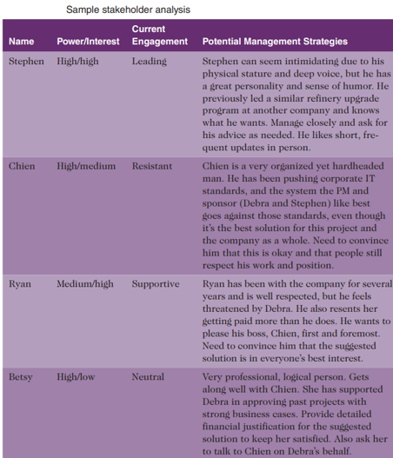
Validate Scope
Sample Stakeholder Analysis

Slide 24
3.Managing Stakeholder Engagement
Utilising the stakeholder engagement plan for relationship-building is crucial after its formation.
Consistent, open, and inclusive communication increases the likelihood of gaining the trust of stakeholders.
For success, it is essential to establish transparent communication channels and a forum where all parties can express their thoughts.

Slide 25
Managing Stakeholder Engagement – cont’d
Although it's uncommon to accomplish scope, time, and cost targets without altering at least one, many practitioners define project success as meeting the client’s or sponsor’s needs.
At this step expectations management matrix is vital to help keep track of the sponsor’s expectations.
Project sponsors can usually rank scope, time, and cost goals in order of importance and provide guidelines on balancing the triple constraint.

Slide 26
4. Monitoring Stakeholder Engagement
Stakeholders are beyond the project manager’s control, but you can monitor their involvement.
Engagement entails a conversation where participants look for understanding and answers to problems that affect them both.
Project managers should set the stage for engaging stakeholders early in the project by inviting them to participate in a kick-off meeting.

Slide 27
Monitoring Stakeholder Engagement– cont’d
The project schedule should include activities and deliverables related to stakeholder engagement, such as surveys, reviews, demonstrations, and sign-offs.
Stakeholders are interested in knowing if their recommendations are considered, what mitigation strategies will be employed, and how the results are being tracked.
Making monitoring results and significant changes publicly available is a good practice to keep other stakeholders informed.

Slide 28
Section Four
Conclusion

Slide 29

Conclusion
Project Stakeholder Management is an essential step in any project management undertaking, as it helps to identify and analyse stakeholder expectations and their impact on the project.
The process consists of four steps: identifying stakeholders, planning stakeholder engagement, managing stakeholder engagement, and monitoring stakeholder engagement.
A stakeholder register is a straightforward approach to capturing basic information about project stakeholders.

Slide 30

Conclusion
The project manager needs to be aware of the organisation's politics, communicate with stakeholders, create potential management strategies, and update the stakeholder management plan.
To manage stakeholder engagement, consistent, open, and inclusive communication is essential, and an expectations management matrix is essential to help keep track of the sponsor's expectations.

Slide 31
References
“Information Technology Project Management ”, Kathy Schwalbe, 2016, Cengage Learning, ISBN 978-1-285-45234-0
“Project Management for IT-Related Projects” , Bob Hughes (editor), 2012, BCS, ISBN 978-1-78017-118-0

